Slide 1

BANK ANALYTICS

Slide 2


CONTENTS
Year wise loan amount Stats
Grade and Sub-Grade wise revolving balance
Total Payment for Verified and Non-Verified Status
State wise AND Month wise loan status
Home ownership Vs last payment date stats

Slide 3

Project Objective
The Bank Loan of Customers project involved analyzing the growth of a bank's loans over a period of years using two Datasets with 39k rows each.
The analysis involved using MS-Excel, MySQL, Tableau, and Power BI tools for cleaning, calculations, merging, and creating interactive dashboards.
Dataset : Finance_1 , Finance_2

Slide 4
39717
Total Customer
445.60M
Total Loan Sanctioned
388.96M
Total Loan Recovered
56.64M
Outstanding Debt
CARDS

Slide 5
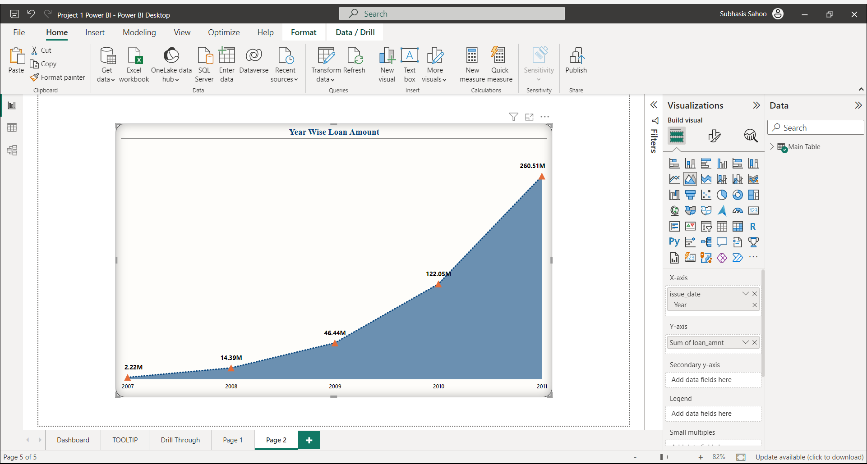
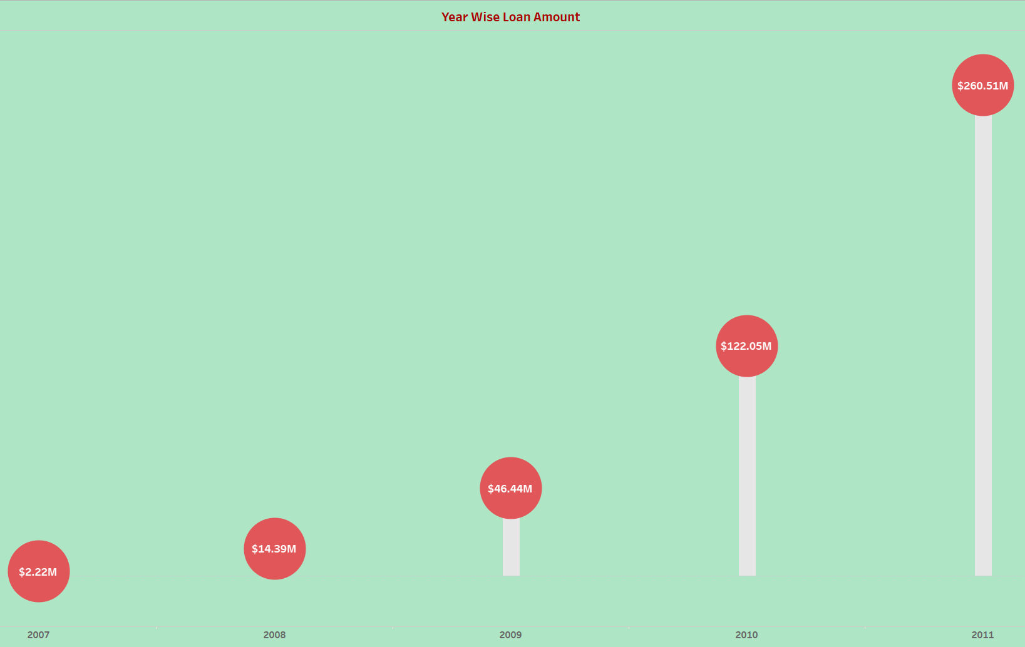
KPI- 1
OBSERVATIONS
2007: Loan Amount – 2.22M
2011: Loan Amount – 261M
Increase: 259 over 4 years
Grand Total (All Years): 446M
SUGGESTIONS
The upward trend in loan amounts, evident in the chart, signifies a growing interest among customers in availing loans.
To capitalize on this opportunity, we propose expanding our marketing efforts and introducing more attractive interest rates, thereby boosting profitability
CONCLUSION
We've delved deep into the numbers, watching them rise and fall over the years.
This tells us a story of financial trends and customer trust.

Slide 6
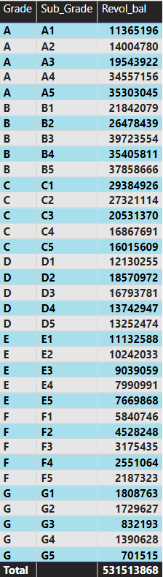
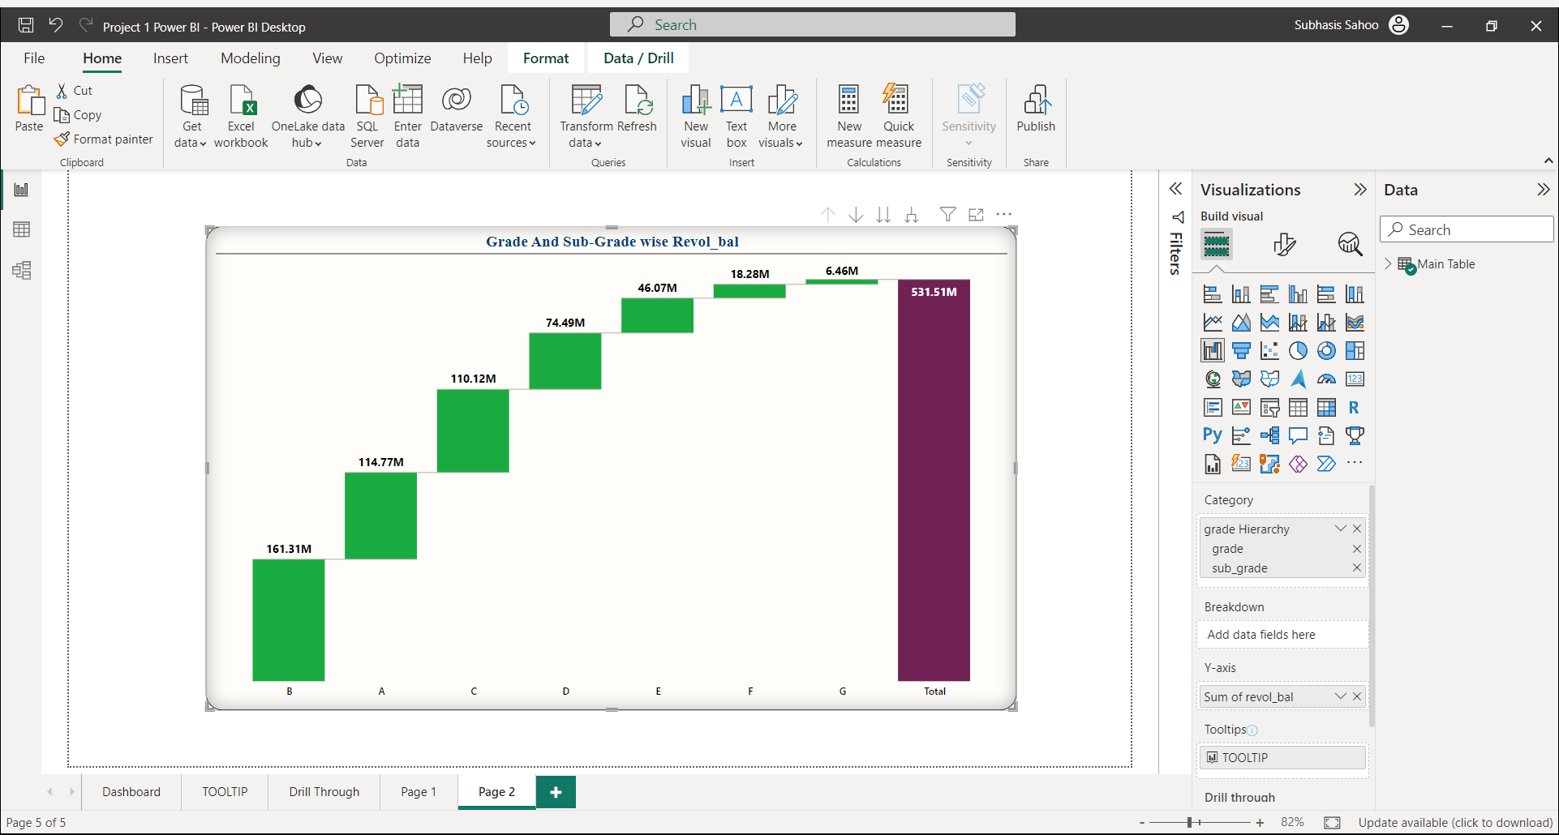
KPI- 2
OBSERVATIONS
Highest Revol_Bal : Grade-B (161.31M)
Sub_Grade- B3(40M)
Lowest Revol_Bal : Grade-G (6.46M)
Sub_Grade- G5(0.7M)
SUGGESTIONS
This understanding can inform lending strategies, enabling financial institutions to target borrowers with higher creditworthiness while maintaining rigorous risk management practices.
CONCLUSION
Creditworthiness and revolving balances are positively correlated. Borrowers with higher credit scores typically maintain larger revolving balances, demonstrating greater credit capacity and responsible credit usage

Slide 7
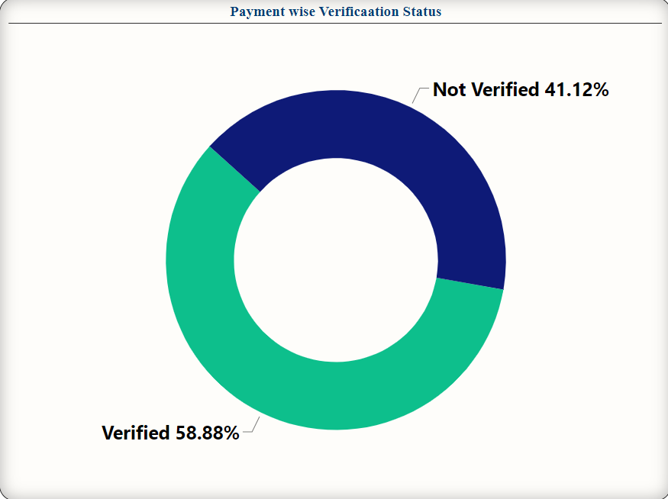
KPI- 3
OBSERVATIONS
The analysis reveals that Verified Status accounts for 59% of total payments, while Non-Verified Status comprises 41%.
SUGGESTIONS
Enhancing the verification rate through robust and efficient procedures has the potential to increase the proportion of Verified Status applications while concurrently mitigating risks associated with Non-Verified Status
Total Payment
373M
CONCLUSION
The analysis shows that the majority of payments come from Verified Status applicants, emphasizing the need for improved verification processes to enhance lending efficiency

Slide 8
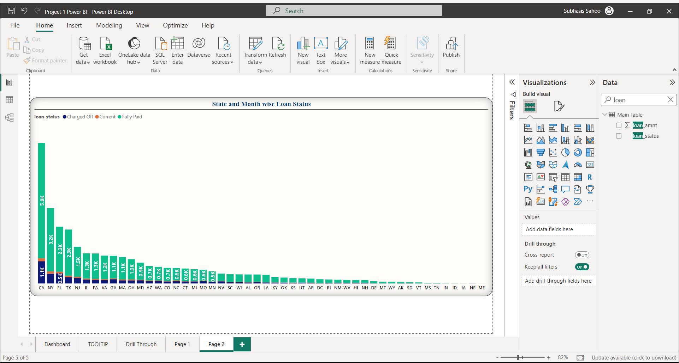
KPI- 4
OBSERVATIONS
California has the highest number of accounts across all loan statuses, particularly in the "Fully Paid(5.8K)" category, compared to Maine's lowest number.
CONCLUSION
The data shows that state-level factors matter for loan status.
California has a big impact on "Fully Paid" status, while Maine's fewer accounts indicate regional differences.
SUGGESTIONS
Analyzing Top3(CA,NY,FL) states can uncover local economic factors, customer behaviors, and market dynamics that impact loan status.
This information guides strategies for risk management, collections, and marketing.

Slide 9
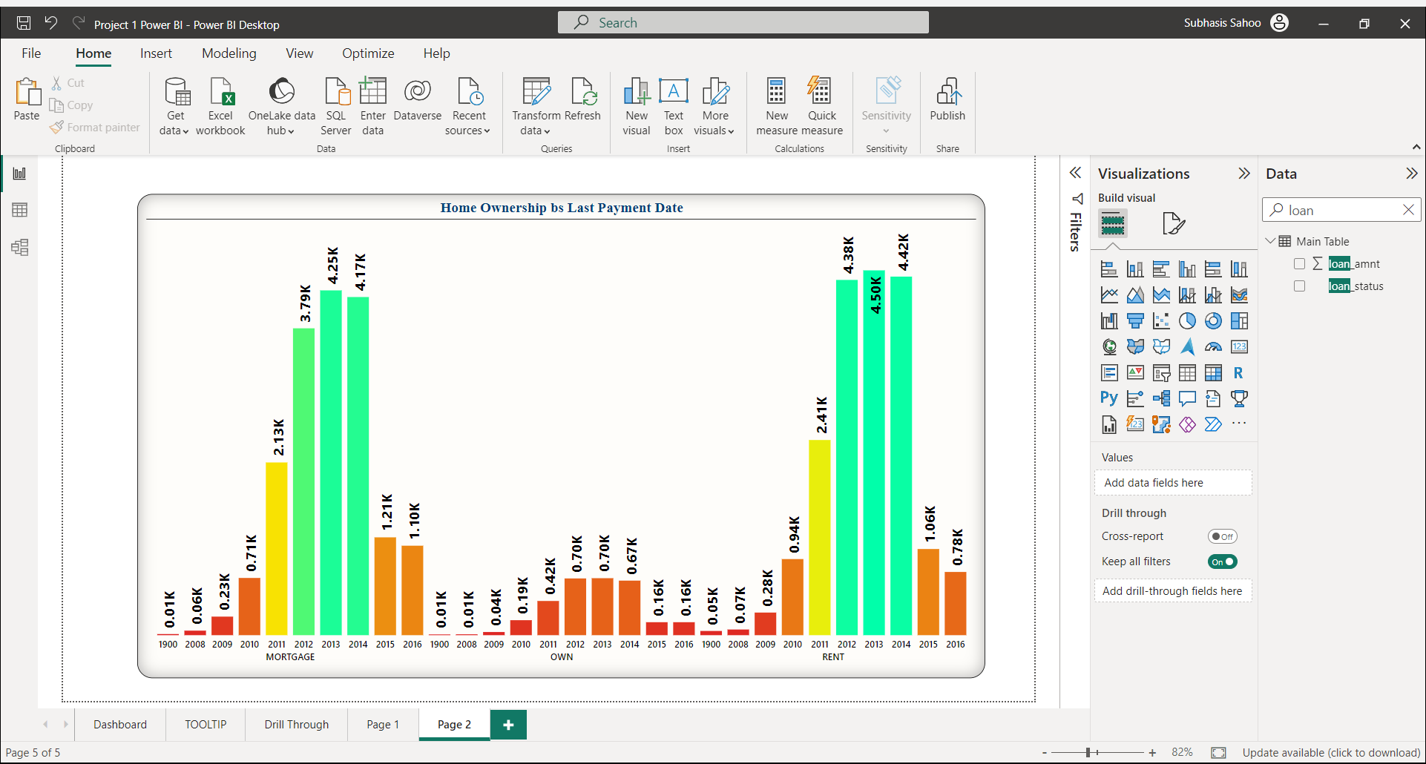
KPI- 5
OBSERVATIONS
These are three types of home ownership: mortgage, own, and rent, with 2013 being the highest and Lowest in 2008.
SUGGESTIONS
Analyzing housing trends requires understanding the factors that drive homeownership, such as economic conditions, government policies, and demographic shifts, to make informed decisions.
CONCLUSION
The bar plot illustrates the changing landscape of home ownership between 2008 and 2016. The peak in 2013 suggests a housing boom, while the lower figure in 2008 may be attributed to the global financial crisis.

Slide 10

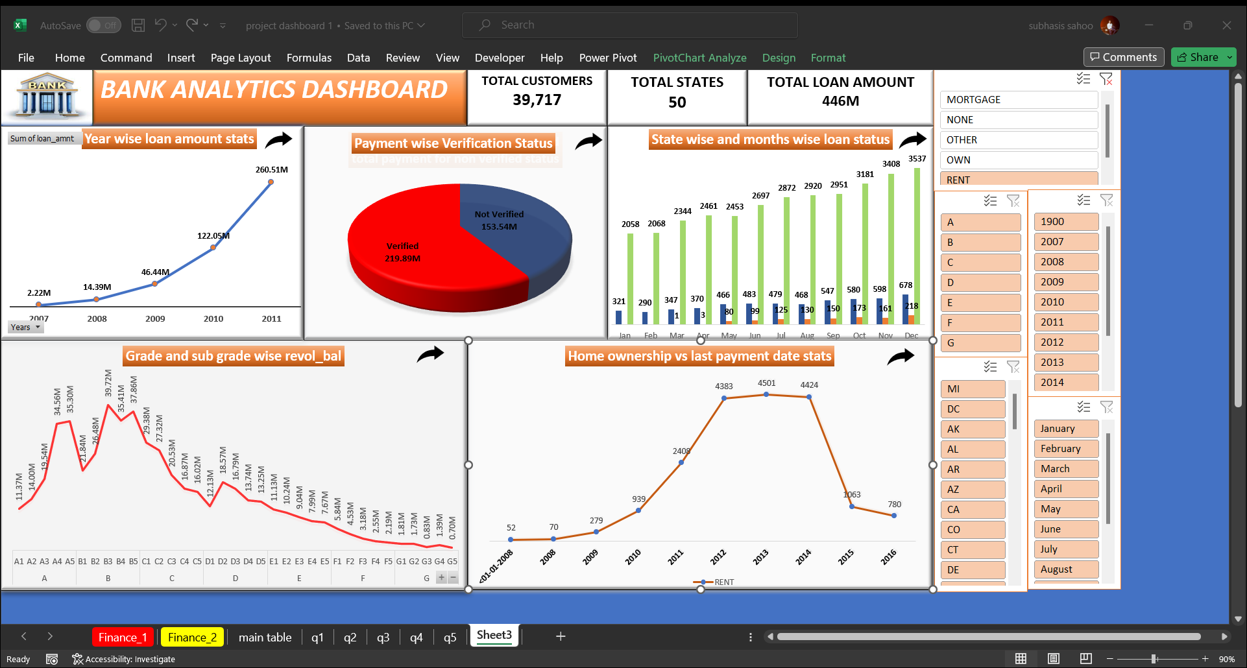

Slide 11

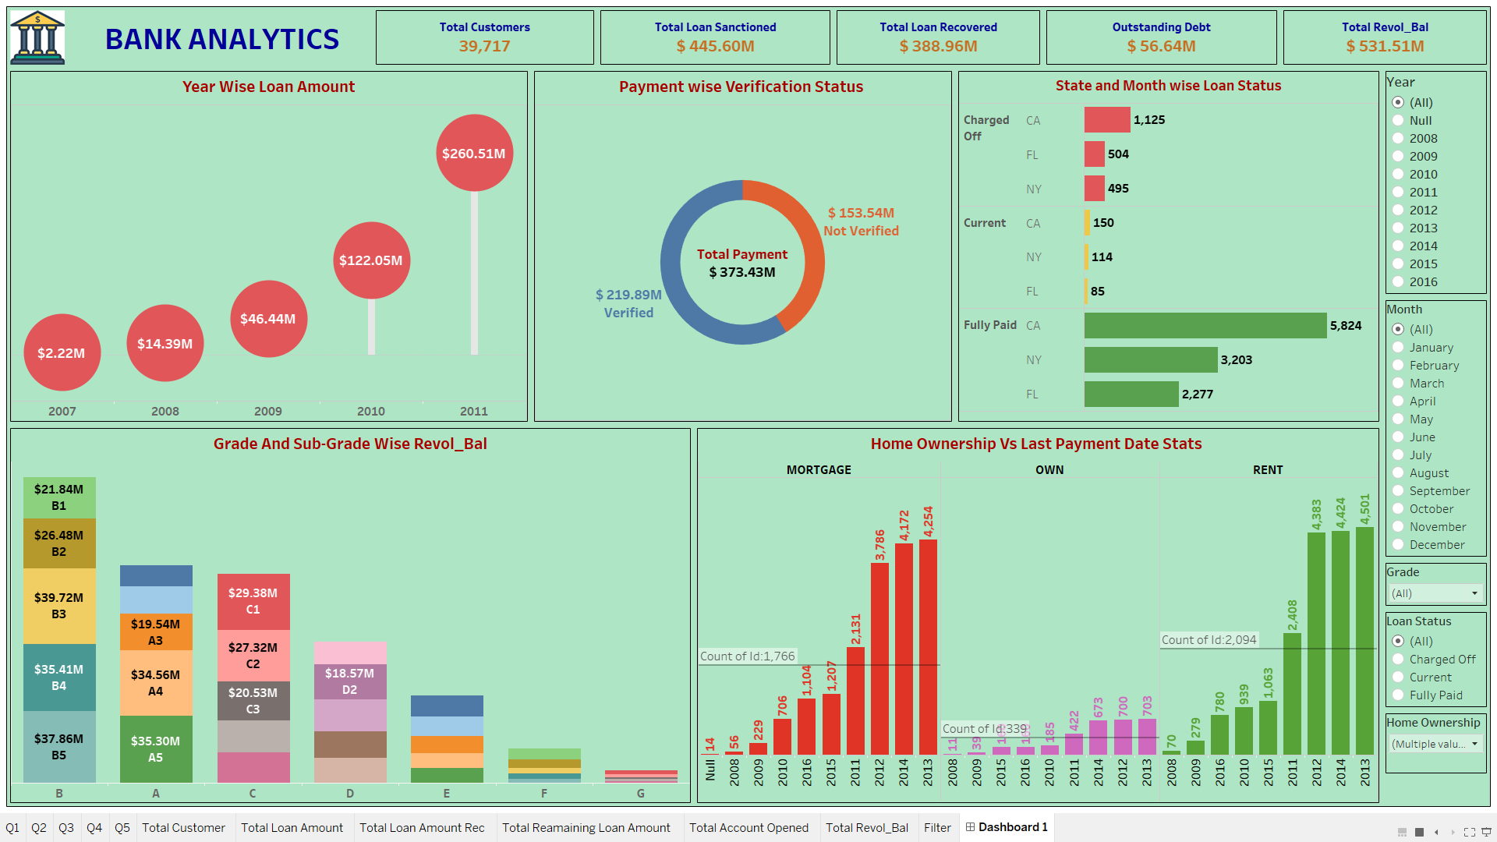

Slide 12

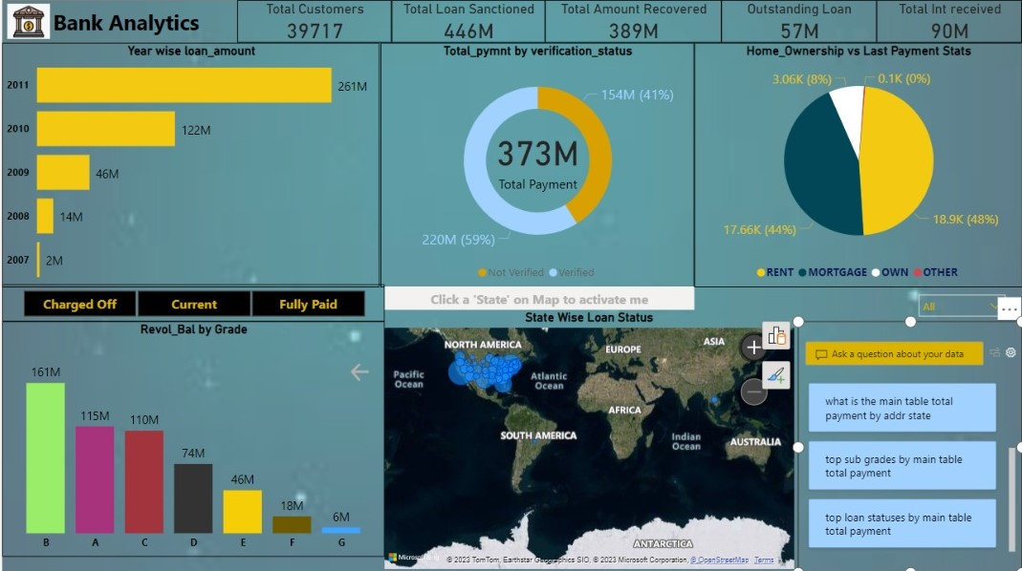

Slide 13

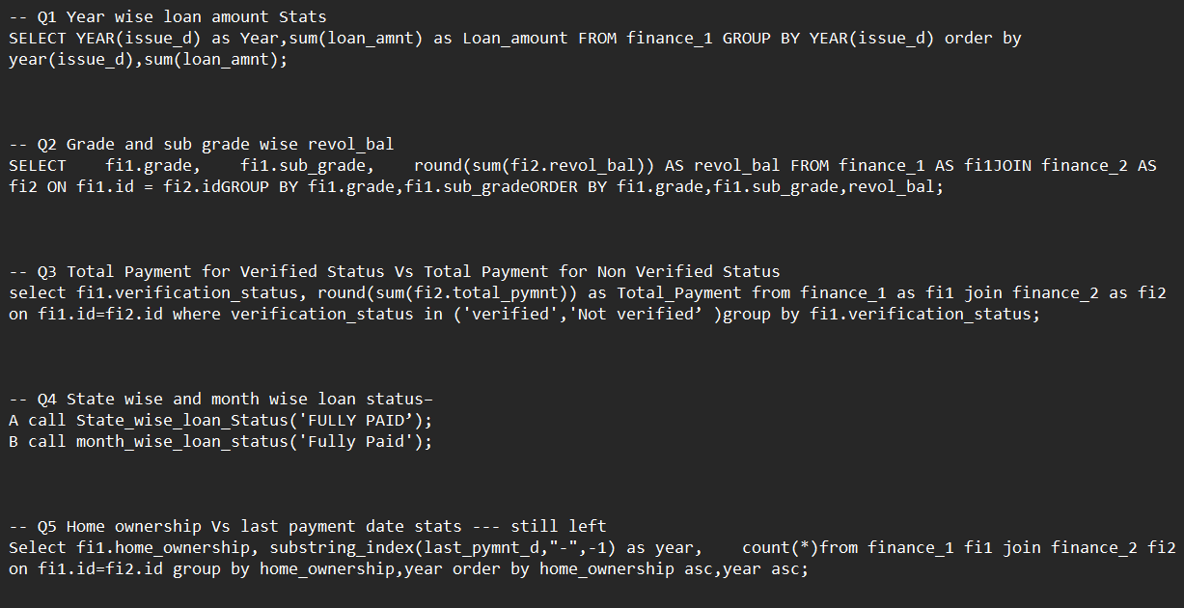

Slide 14

CONCLUSION
We use data analysis to find important insights from reports, helping organizations make smart decisions. By looking at key indicators in finance data, we enable precise choices, revealing current operations and ensuring business health. This data-driven approach keeps businesses adaptable and confident in a changing world.

Slide 15
THANK YOU

